Slide 1

DIGITAL MARKETING PROJECT
PROJECT TITLE: EVENT_HORIZON
JOES AROCKIAM X -2133020

Slide 2


About Event Horizon
Welcome & Vision
Welcome to Event Horizon, where we transcend the ordinary to curate unforgettable moments. Our mission is to bring your vision to life, from enchanting birthday parties to elegant weddings.
Expertise
We specialize in crafting extraordinary experiences for a myriad of celebrations. Our team excels in creating atmospheres that resonate with your personality and style.
Service Offerings
We are dedicated to making your dreams a reality. We excel in turning ideas into immersive events that linger in the memories of your guests.

Slide 3
Problem Statement
Challenges Faced
Balancing innovation and tradition in the events industry. Meeting diverse client expectations. Adapting to dynamic market demands.
Key Issues
Logistical challenges, vendor management, ensuring a seamless client experience.
Core Challenge
Need to sustain and enhance Event Horizon's position as a leader in the industry.

Slide 4

STRATEGY FORMULATED
1
2
3
4
Leveraging popular social media platforms like Instagram, Facebook, and Twitter to showcase visually appealing images of our services.
Collaborating with influencers to reach a wider audience and create a buzz around our events and services.
Implementing an online booking and contacting system to provide a seamless user experience and easy access to our services.
Regularly analyzing digital marketing metrics, conversion rates, and social media engagement to measure the effectiveness of our digital marketing strategies and make data-driven decisions.

Slide 5

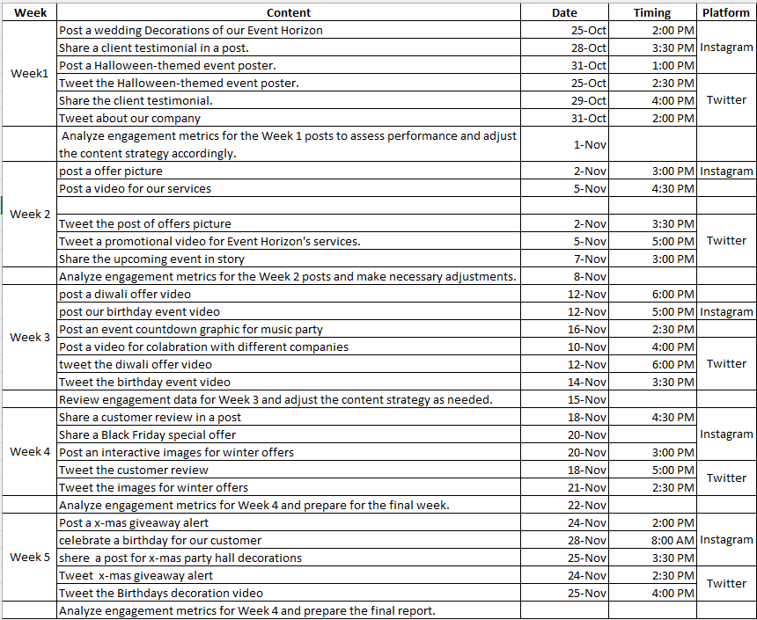
OUR CALENDER (PHASE 2)

Slide 6

PROGRESS (PHASE – 3)
CAMPAIGN OVERVIEW
KEY ACTIVITIES
Platform: Instagram and Twitter
Content Type: Posts, Reels and Tweets
Timeline: As per the marketing calendar
Drive Link: drive link
Content Scheduling: All posts and reels were scheduled in advance
Hashtag Optimization: Relevant hashtags were identified and incorporated to enhance discoverability and engagement

Slide 7

ANALYTICS REPORT (PHASE – 4)
2200
30%
+80%
500
Customers
Impression
Conversion Rate
Event Reach Growth
Accounts
reached

Slide 8
CRITICAL ANALYSIS (PHASE – 5)
INSTAGRAM
Key Findings
The critical analysis unveiled several key findings, including the impact of social media engagement on customer traffic, the influence of visual content on customer decisions, and the importance of personalized customer interactions in the event planning industry.
Strengths and Opportunities
The company demonstrated strengths in creative event design and execution. Additionally, opportunities for growth were identified in the digital marketing domain, leveraging technology for process improvements, and expanding service offerings.
Weaknesses and Threats
The critical analysis also highlighted certain weaknesses, such as the need for better customer feedback mechanisms and identified potential threats from emerging competitors in the market.

Slide 9
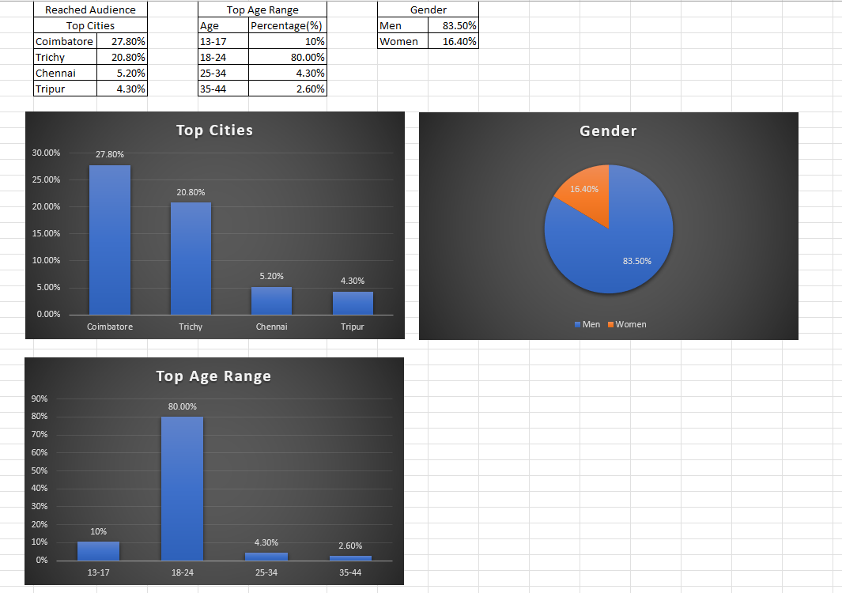
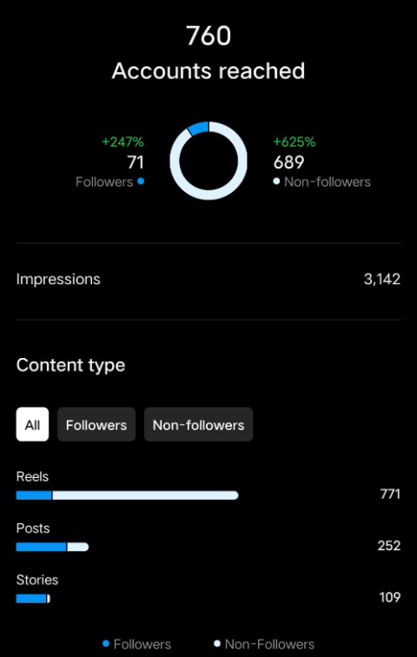

Slide 10

CRITICAL ANALYSIS (PHASE – 5)
Twitter
Key Findings
Despite the success of the digital marketing campaigns, there were some critical areas that needed attention. The analysis revealed that certain aspects required improvement for better results.
Strategic Impact
The digital marketing strategies significantly impacted brand visibility and customer engagement. However, there were specific areas where the strategies fell short of expectations.
Areas for Improvement
The analysis identified several areas that require improvement, including content quality, customer interaction, and conversion rates. These are the key areas to focus on for the next phase of the marketing campaign.

Slide 11
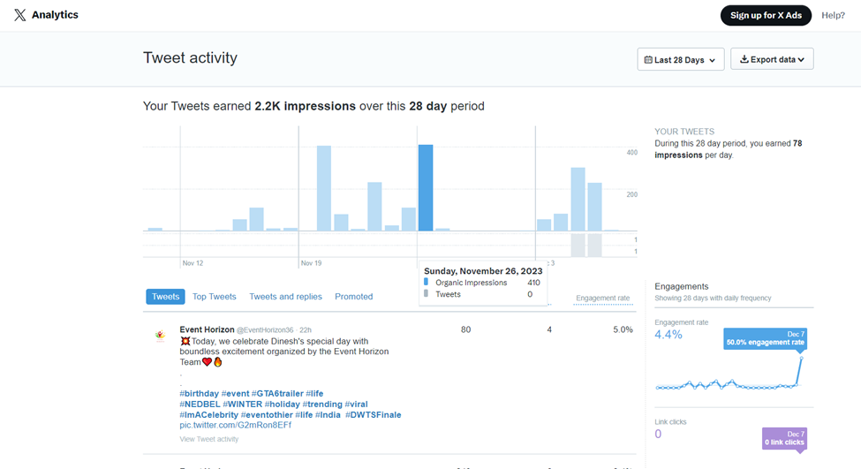
CRITICAL ANALYSIS (PHASE – 5)
Twitter

Slide 12
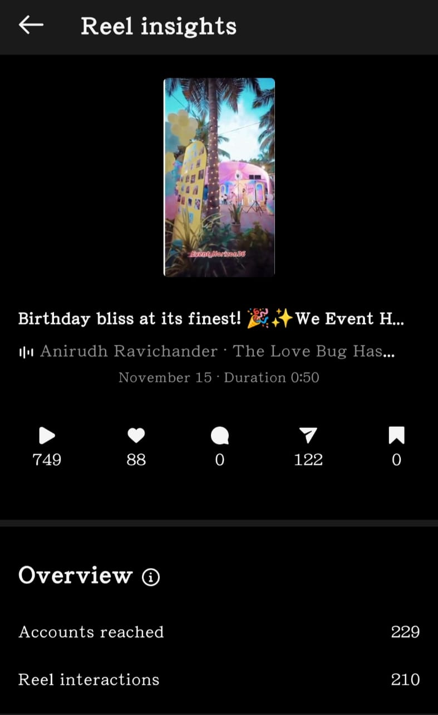
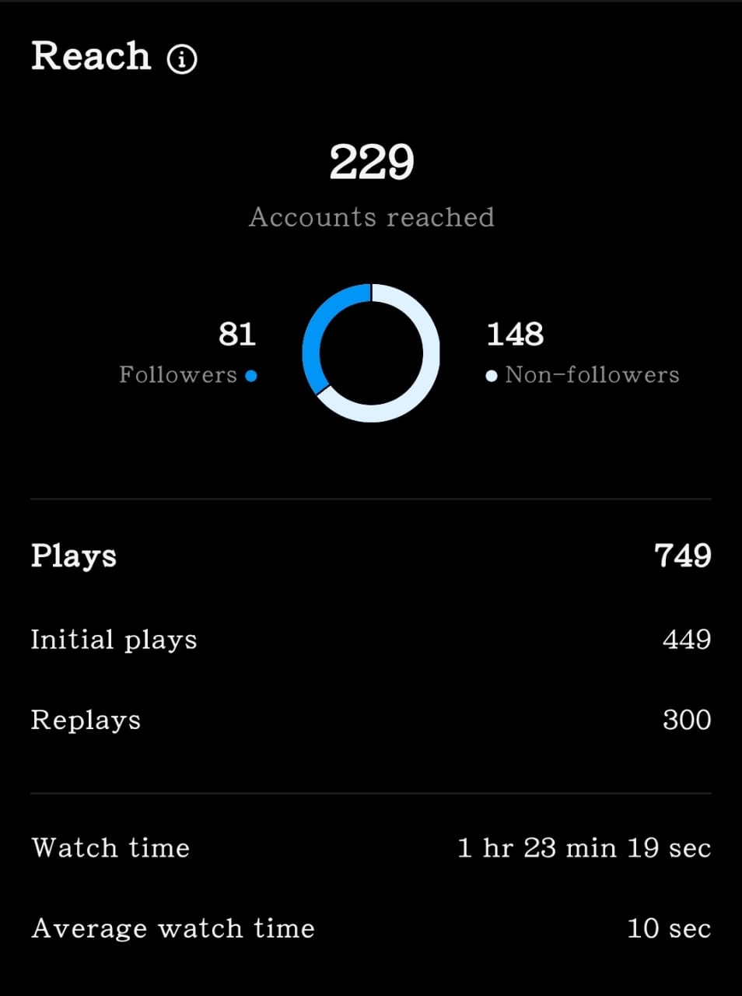
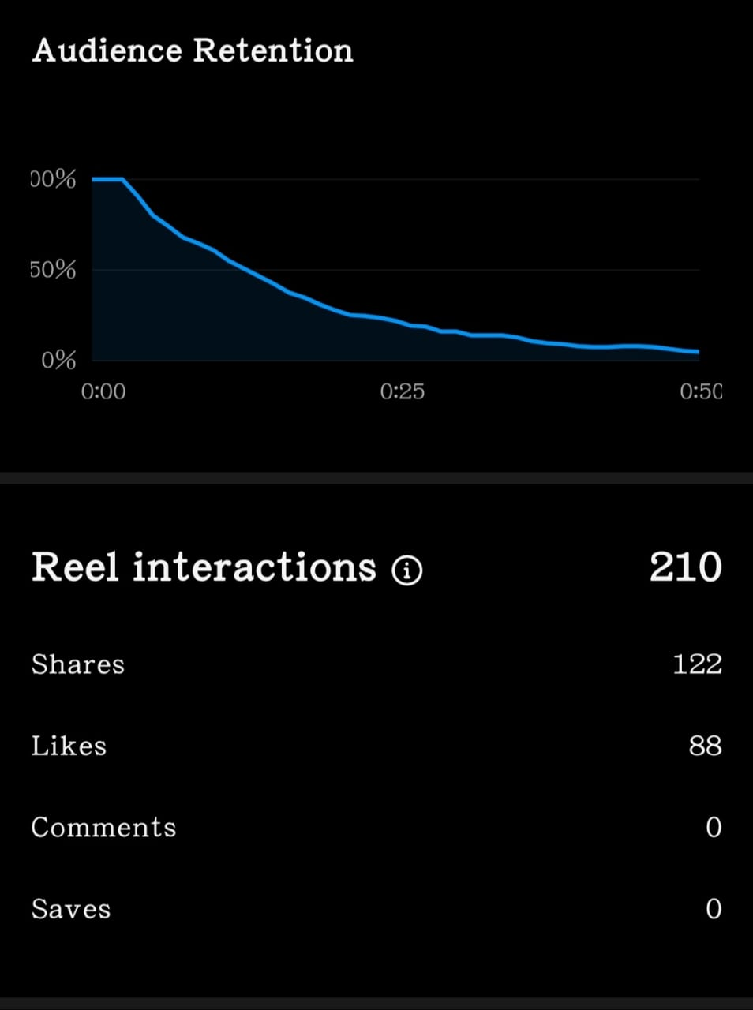
One of the Milestone Achieved

Slide 13
Detailed analysis
01
02
03
Emphasize the importance of personalization, tech integration, and client engagement.
Summarize valuable insights gained from participant feedback.
Engagement Strategies: Live polls, interactive VR elements, and real-time social media integration.
Client Testimonials: Quotes from satisfied clients highlighting the success of the campaign.
A well-executed social media strategy significantly contributed to success. Regular posts, interactive campaigns, and community engagement fostered a strong online presence and built a loyal customer base.

Slide 14

Suggestions for improving
Investing in professional photography and videography to elevate the quality of visual content.
1
Establishing a robust system for collecting, analyzing, and responding to customer feedback.
2
Actively seeking input through surveys, social media polls, or in-store interactions to understand customer preferences and areas for improvement.
3
Exploring partnerships with local influencers or complementary businesses to expand reach and tap into new audiences.
4

Slide 15


